Slide 2
What Is Frequent Pattern Analysis?
Frequent pattern: a pattern (a set of items, subsequences, substructures, etc.) that occurs frequently in a data set
First proposed by Agrawal, Imielinski, and Swami [AIS93] in the context of frequent itemsets and association rule mining
For example, a set of items, such as milk and bread, that appear frequently together in a transaction data set is a frequent itemset.
A subsequence, such as buying first a PC, then a digital camera, and then a memory card, if it occurs frequently in a shopping history database, is a (frequent) sequential pattern.

Slide 3
A substructure can refer to different structural forms, such as subgraphs, subtrees, which may be combined with itemsets or subsequences. If a substructure occurs frequently, it is called a (frequent) structured pattern.

Slide 4
Motivation and Applications
Motivation: Finding inherent regularities in data
What products were often purchased together?— Beer and diapers?!
What are the subsequent purchases after buying a PC?
What kinds of DNA are sensitive to this new drug?
Can we automatically classify web documents?
Applications
Basket data analysis, cross-marketing, catalog design, sale campaign analysis, Web log (click stream) analysis, and DNA sequence analysis.
Notes:
clickstream is the recording of the parts of the screen a computer user clicks on while web browsing or using another software application. As the user clicks anywhere in the webpage or application, the action is logged on a client or inside the web server, as well as possibly the web browser, router, proxy server or ad server. Clickstream analysis is useful for web activity analysis,^{[1]} software testing, market research, and for analyzing employee productivity.

Slide 5
Frequent patterns
Finding Frequent patterns is a foundation for many essential data mining tasks
Association, correlation, and causality analysis
Sequential, structural (e.g., sub-graph) patterns
Pattern analysis in spatiotemporal, multimedia, time-series, and stream data
Classification: discriminative, frequent pattern analysis
Cluster analysis: frequent pattern-based clustering
Data warehousing: iceberg cube and cube-gradient
Semantic data compression: fascicles
Broad applications
Notes:
A spatiotemporal database is a database that manages both space and time information. Common examples include:
Tracking of moving objects, which typically can occupy only a single position at a given time.
A database of wireless communication networks, which may exist only for a short timespan within a geographic region.

Slide 6
Basic Concepts: Frequent Patterns
Tid | Items bought
10 | Beer, Nuts, Diaper
20 | Beer, Coffee, Diaper
30 | Beer, Diaper, Eggs
40 | Nuts, Eggs, Milk
50 | Nuts, Coffee, Diaper, Eggs, Milk
A set of items is referred to as an itemset.
An itemset that contains k items is a k-itemset. A k-Itemset: {Ii1,Ii2, …, Iik} ⊆ I
The set of computer, antivirus software e.g is a 2-itemset.
The occurrence frequency of an itemset is the number of transactions that contain the itemset.
This is also known, simply, as the frequency, absolute support count, or count of the itemset.
Set of database transactions: D={t1,t2, …, tn}, each transaction t is a nonempty itemset such that tj ⊆ I
Relative Support of an itemset: Percentage of transactions that contain that itemset.
Large (Frequent) itemset: Itemset whose number of occurrences is above a threshold.
Customer
buys both
Customer
buys diaper
Customer
buys beer

Slide 7
Tid | Items bought
10 | Beer, Nuts, Diaper
20 | Beer, Coffee, Diaper
30 | Beer, Diaper, Eggs
40 | Nuts, Eggs, Milk
50 | Nuts, Coffee, Diaper, Eggs, Milk
I = { Beer, Nuts, Diaper, Cofee, Eggs, Milk}
Support of {Bear, Diaper} = 3/5 = 60%

Slide 8
Association Rules
Implication: X ➔ Y where X,Y ⊆ I and X ∩Y = ∅;
Support of AR X ➔ Y:
Percentage of transactions that contain X ∪ Y
Probability that a transaction contains X∪Y.
Confidence of AR X ➔ Y:
Ratio of number of transactions that contain X ∪ Y to the number that contain X
Conditional probability that a transaction having X also contains Y.

Slide 9
Transaction-id | Items bought
10 | A, B, C
20 | A, C
30 | A, D
40 | B, E, F
For rule A ➔ C:
Support(A➔C) = P(A∪C) =
support({A} ∪ { C}) = 50%
Confidence (A➔ C) = P(C|A)
= support({A}∪{C})/support({A})
= 66.6%
Rules that satisfy both a minimum support threshold (min sup) and a minimum confidence threshold (min conf ) are called strong.
Frequent pattern | Support
{A} | 75%
{B} | 50%
{C} | 50%
{A, C} | 50%

Slide 10
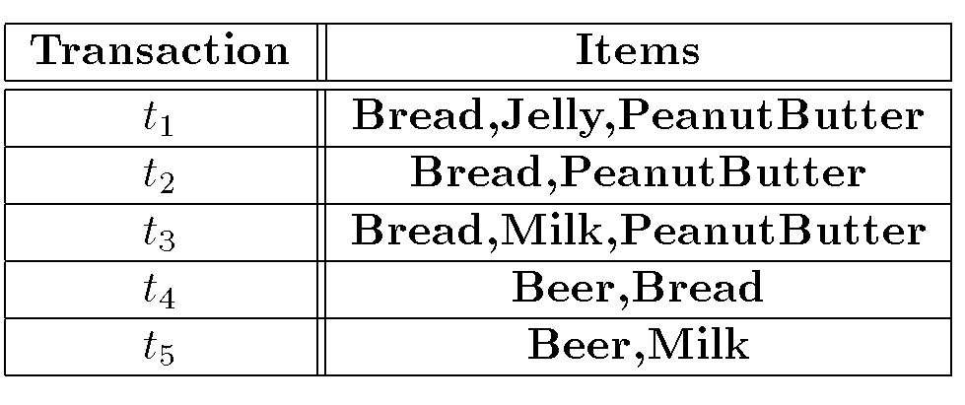
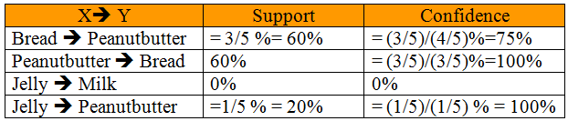

Slide 11
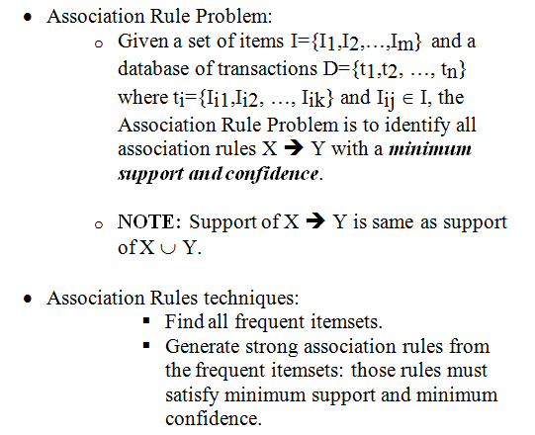
Association Rule Problem

Slide 12
Market Basket Analysis: A Motivating Example
Frequent itemset mining leads to the discovery of associations and correlations among items in large transactional or relational data sets.
With massive amounts of data continuously being collected and stored, many industries are becoming interested in mining patterns from their databases.
The discovery of interesting correlation relationships can help in many business decision-making processes such as catalog design, cross-marketing, and customer shopping behavior analysis.

Slide 13
Contd
A typical example of frequent itemset mining is market basket analysis.
This process analyzes customer buying habits by finding associations between the different items that customers place in their “shopping baskets”
As manager you might be interested in
“Which groups or sets of items are customers likely to purchase on a given trip to the store?”
Apply market basket analysis to plan marketing or advertising strategies, or in the design of a new catalog.

Slide 14
Contd
For instance, market basket analysis may help you design different store layouts.
In one strategy, items that are frequently purchased together can be placed in proximity to further encourage the combined sale of such items.
If customers who purchase computers also tend to buy antivirus software at the same time, then placing the hardware display close to the software display may help increase the sales of both items.

Slide 15
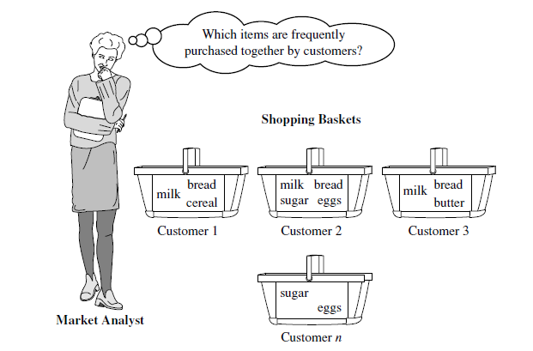
Contd..
Market basket analysis can also help retailers plan which items to put on sale at reduced prices. If customers tend to purchase computers and printers together, then having a sale on printers may encourage the sale of printers as well as computers.

Slide 16
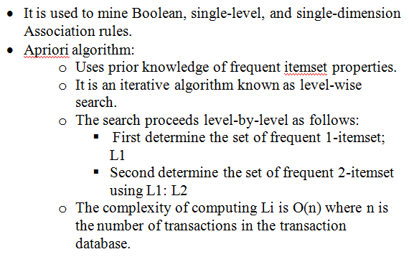
Apriori Algorithm

Slide 17
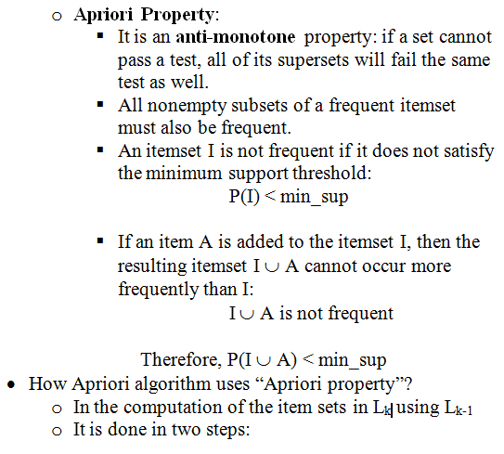

Slide 18
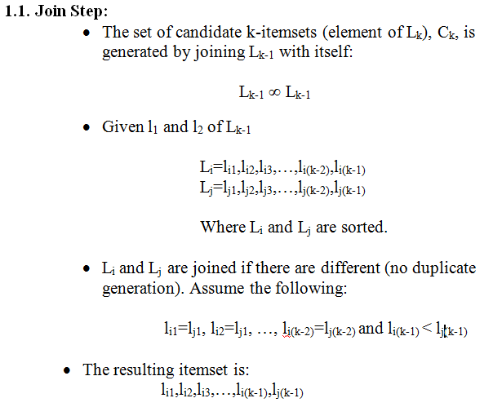

Slide 19
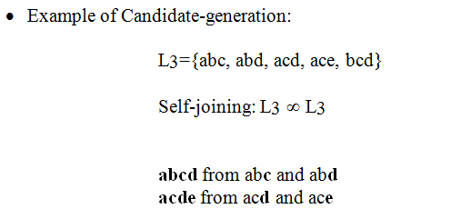

Slide 20
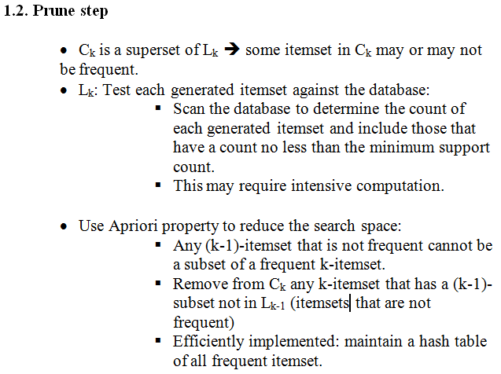

Slide 21
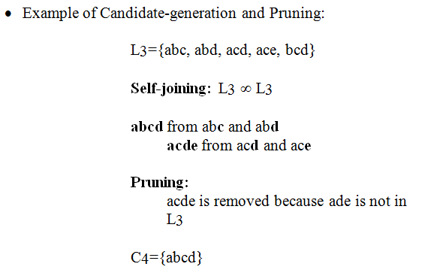

Slide 22
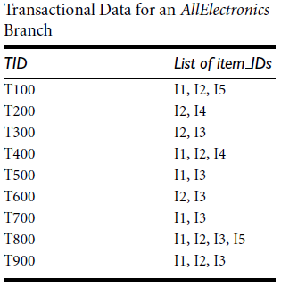
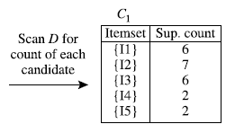
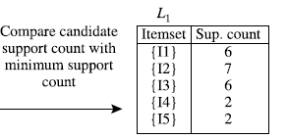
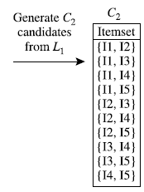
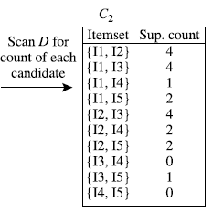
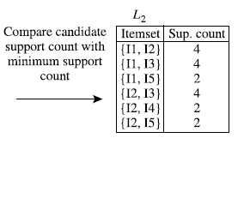
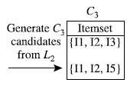
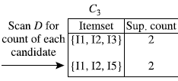
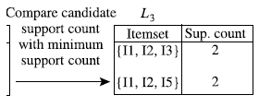

Slide 23


Slide 24
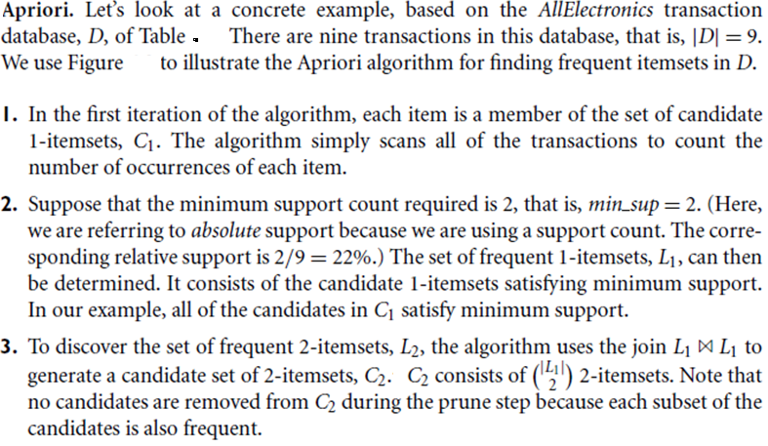
Apriori Algorithm

Slide 25
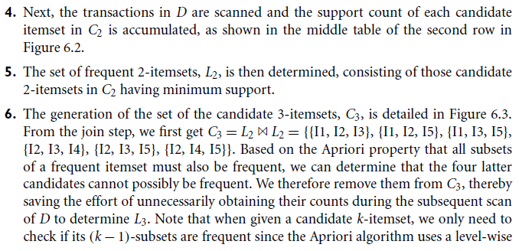
Apriori Algorithm

Slide 26
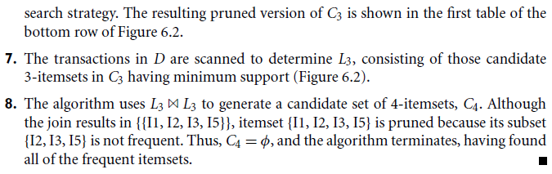
Apriori Algorithm

Slide 27
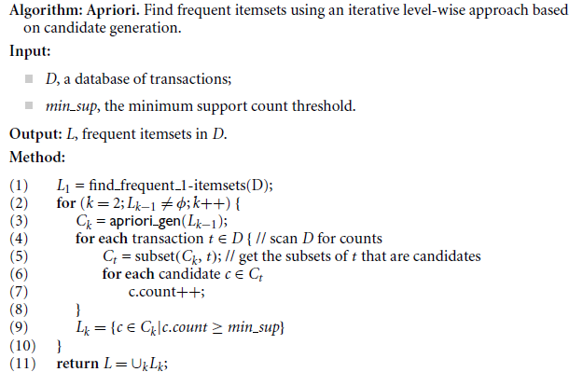
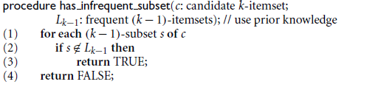
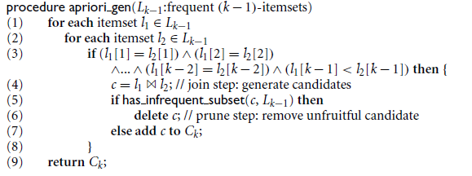

Slide 28


Generating Association Rules from Frequent Itemsets
Once the frequent itemsets from transactions in a database D have been found, it is straightforward to generate strong association rules from them.
Strong association rules satisfy both minimum support and minimum confidence).
Based on this equation, association rules can be generated as follows:

Slide 29
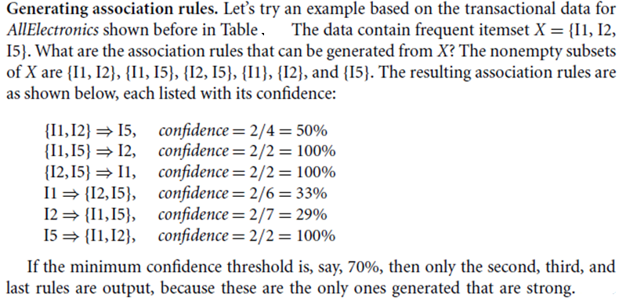
Because the rules are generated from frequent itemsets, each one automatically satisfies the minimum support.

Slide 30
FP growth Algorithm
FP growth Algorithm mines frequent itemset without candidate set generation.
Disadvantages of Apriori Algorithm
Generate huge number of candidate sets
Repeadlty scan the database and check a large set of candidates by pattern matching
Computationally expensive (more time and memory)

Slide 31
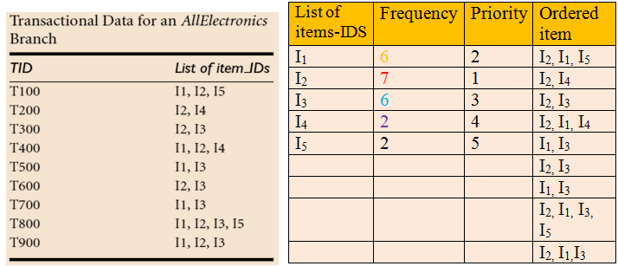
FP growth Algorithm
We re-examine the mining of transaction database, D, of Table from previous example using the frequent pattern growth approach.
The first scan of the database is the same as Apriori, which derives the set of frequent items (1-itemsets) and their support counts (frequencies). Min Supp=2
FP growth is used to find frequent itemset for the ordered data set.
Data set is ordered based on priority of each item
Create FP tree for the ordered data set.
Conditional Base Pattern----------------------> Frequent patterns
Notes:
FP

Slide 32
An FP-tree is then constructed as follows. First, create the root of the tree, labeled with “null.” Scan database D a second time. The items in each transaction are processed in L order (i.e., sorted according to descending support count), and a branch is created for
each transaction.
For example, the scan of the first transaction, “T100: I1, I2, I5,” which contains three items (I2, I1, I5 in L order), leads to the construction of the first branch of the tree with three nodes, I₂: 1, I₁:1, and I₅: 1, where I₂ is linked as a child of the root, I₁ is linked to I₂, and I₅ is linked to I₁.
(1) l2, l1, l5
null
I₂:1
I₁:1
I₅:1

Slide 33
2nd Transaction
null
(2) l2, l4
I₂:2
I₁:1
I₄:1
I₅:1

Slide 34
3rd Transaction
null
(3) l2, l3
I₂:3
I₃:1
I₁:1
I₄:1
I₅:1

Slide 35
4th Transaction
null
(4) l2, l1, l4
I₂:4
I₃:1
I₁:2
I₄:1
I₅:1
I₄:1

Slide 36
5th Transaction
null
(5) l1, l3
I₂:4
I₁:1
I₃:1
I₁:2
I₄:1
I₃:1
I₅:1
I₄:1

Slide 37
6th Transaction
null
(6) l2, l3
I₂:5
I₁:1
I₃:2
I₁:2
I₄:1
I₃:1
I₅:1
I₄:1

Slide 38
7th Transaction
null
(7) l1, l3
I₂:5
I₁:2
I₃:3
I₁:2
I₄:1
I₃:2
I₅:1
I₄:1

Slide 39
8th Transaction
null
(8) l2, l1, l3, l5
I₂:6
I₁:2
I₃:3
I₁:3
I₃:1
I₄:1
I₃:2
I₅:1
I₅:1
I₄:1

Slide 40
9th Transaction
null
(9) l2, l1, l3
I₂:7
I₁:2
I₃:3
I₁:4
I₃:2
I₄:1
I₃:2
I₅:1
I₅:1
I₄:1

Slide 41
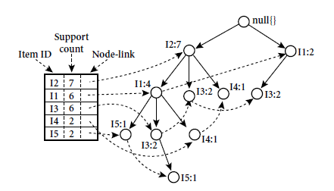

Slide 42
Mine Frequent Pattern from FP Tree
Conditional Pattern Base
Start from the node with min support, I₅
2. Exclude the node the max support, I₂ (max support=7)

Slide 43
Now we will mine frequent patterns from this tree
Item set l5
{{l2, l1, l5 : 1},{l2, l1, l3, l5 : 1}}
{{l2, l1, l5 : 1},{l2, l1, l3, l5 : 1}}
{l2, l1} {l2, l1, l3}
{l2, l1 : 2} >= which satisfies the minimum support
Now construct conditional tree for {l2, l1 : 2}
null
This path generates all possible combinations of FP
L2:2
Make subsets of tree with l5
{l2, l5 : 2}, {l1, l5 : 2}, {l2, l1, l5 : 2}
L1:2

Slide 44
Item set l4
{{l2, l1, l4 : 1},{l2, l4 : 1}}
{{l2, l1, l4 : 1},{l2, l4 : 1}}
{l2, l1} {l2}
{l2 : 2} >= which satisfies the minimum support
Now construct conditional tree for {l2 : 2}
null
This path generates all possible combinations of FP
L2:2
Make subsets of tree with l4
{l2, l4 : 2}

Slide 45
Item set l3
{{l1, l3 : 2},{l2, l3 : 2}, {l2, l1, l3 : 2}}
{{l1, l3 : 2},{l2, l3 : 2}, {l2, l1, l3 : 2}}
{l1 : 2}, {l2 : 2},,{l2, l1 : 2}
{l2 : 4, l1 : 2}, {l1 : 2} >= which satisfies the minimum support
Now construct conditional tree for {l2 : 4, l1 : 2}, {l1 : 2}
null
This path generates all possible combinations of FP
L1:2
L2:4
Make subsets of tree with l3
{l2, l2 : 4}, {l1, l3 : 4}, {l2, l1, l3 : 2}
L1:2

Slide 46
Item set l1
{l2, l1 : 4}
{l2 : 4} >= which satisfies the minimum support
Now construct conditional tree for {l2 : 4}
null
This path generates all possible combinations of FP
L2:4
Make subsets of tree with l1
{l2, l1 : 4}

Slide 47
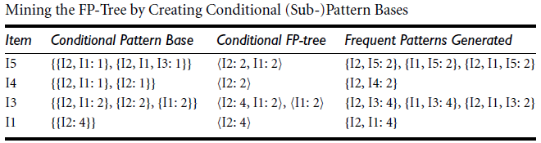
Two paths belong to same sub FP tree
How to interpret the above table
Finding routes reaching I₅.
The path I₂, I₁ reaches I₅ with the count of 1.
The path I₂, I_{1,} I₃ reaches I₅ with the count of 2.
I₂, I₁ count is 2 times, therefore satisfying the min support.
_{Interpretation of Last Column}
Combine the conditional FP (Frequent patterns) in the second last column with Item column
{I₂, I₅:2} …. I₂, I₅ with the count of 2

